Slide 1
Plant Seedlings Classification
Determine the species of a seedling from an image
Presented by Yang Guofeng & Liu Huazhen
2018-7-5

Slide 2
Outline
Background
Related Work
Two different models
Results and Discussion
Conclusion

Slide 3
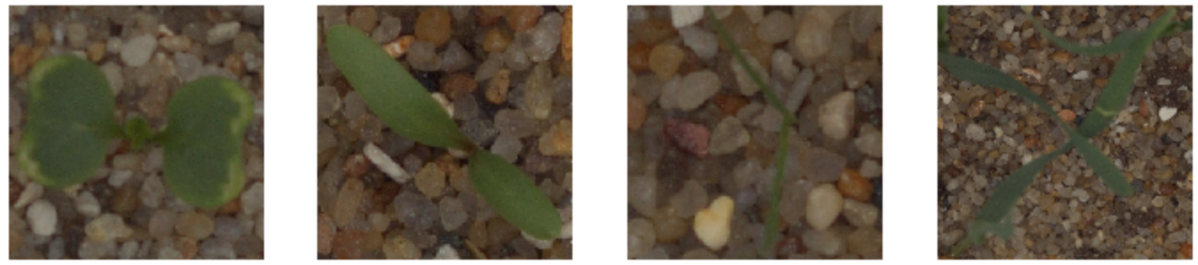
Background
Can you differentiate a weed from a crop seedling?
The ability to do so effectively can mean better crop yields and better stewardship of the environment.
The Aarhus University Signal Processing group, in collaboration with University of Southern Denmark, has recently released a dataset containing images of approximately 960 unique plants belonging to 12 species at several growth stages.

Slide 4
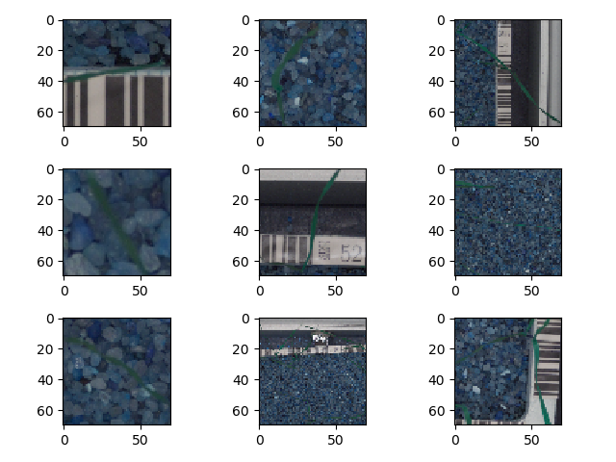
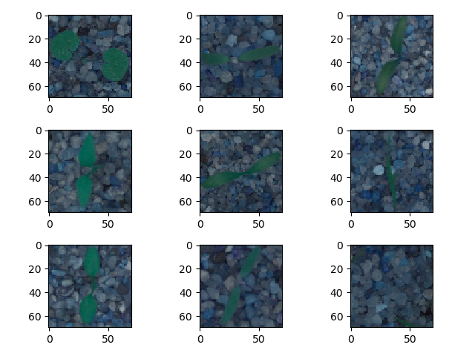
Data set
Train (Black-grass)
Test

Slide 5
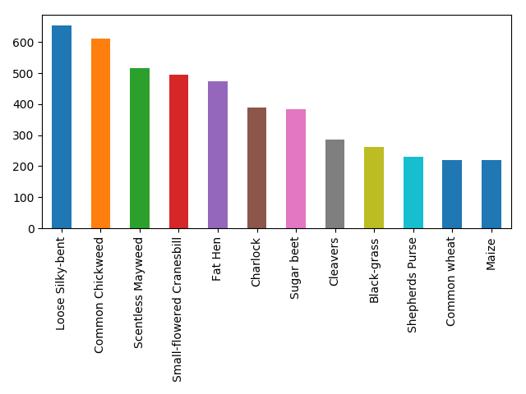
Train data set

Slide 6
Related Work
在基于特征工程的植物叶片识别分类研究方面，在特征选择上，王晓峰^{[1]}提取叶片图像的 8 项几何特征和 7 个图像不变矩，王丽君^{[2]}等提取植物叶片的颜色、纹理、形状等 26 项特征，黄婕^{[3]}等选取了对光线、旋转、缩放、拉伸变换具有一定的鲁棒性的局部特征描述子 SIFT^{[4]}。三位分别学者分别基于移动中心超球分类器实现了 20 多种植物叶片 92%的识别率，基于支持向量机^{[5]}实现了 50 种观叶植物叶片91.41%的识别率，以及 SVM 实现了 53 种植物叶片的识别。在分类器的选择对植物叶片识别效果影响的研究上，Wu^{[6]}和 Priya^{[7]}都提取了 12 种植物叶片形状特征，并都正交化成 5 个主成分来识别 32 种植物叶片，不同的是，Wu 使用概率神经网络实现了90%的识别率，而 Priya 将概率神经网络模型换为支持向量机提高识别率到 92%。在处理复杂植物器官、复杂背景环境的植物识别问题上，Qiang Chen^{[8]}使用 Fisher 视觉特征和线性分类器组合。Gbor Szcs^{[9]}基于稠密 SIFT 特征和 Fisher向量的高斯混合模型及 C-支持向量。Arora^{[10]}针对复叶的植物叶片通过 Grab Cut 拆分为单叶提取形状特征、角特征，针对复杂背景环境的叶片提取 SURF 特征。Dimitrovski^{[11]}将叶片、花、枝干、果实等器官都用于植物识别，对于叶片提取三角形边长为角度特征（TSLA）描述子，对于其他器官通过 Harris-Laplace 检测提取 Opponet SIFT 特征。
以上基于特征工程的植物识别解决方案虽然取得一定的成果，但是它们都依赖于人类工程师设计特征，然后经过繁琐的特征处理过程才能够形成分类器的输入。在这个过程中，数据及特征在一定程度上决定了机器学习所能达到的上限，而采用的算法和模型的好坏决定了逼近该上限的程度。随着数据集种类的增多及外部环境的复杂及人类定义特征的局限性，该方法在识别率及识别种类数上受限。
随着深度学习在识别、检测等领域的发展，基于深度学习的植物叶片识别分类方法得以应用。Mehdipour^{[12]}提出 PCANet 用于植物叶片识别，由于使用主成分分析学习权重，在一定程度上可以缓解训练深度学习网络需要大量数据的问题，但是网络性能有待提升。Ge Z Y^{[13]}、 Choi S^{[14]}、Lee S H^{[15]}、Chazi^{[16]}使用 GoogLe Net 或VGG 来实现植物识别，但是他们都使用了 7 种不同的植物器官作为训练样本，这实际是通过增加样本量及信息来增加模型的经验知识。

Slide 7
Two different models
1
Yang Guofeng

Slide 8
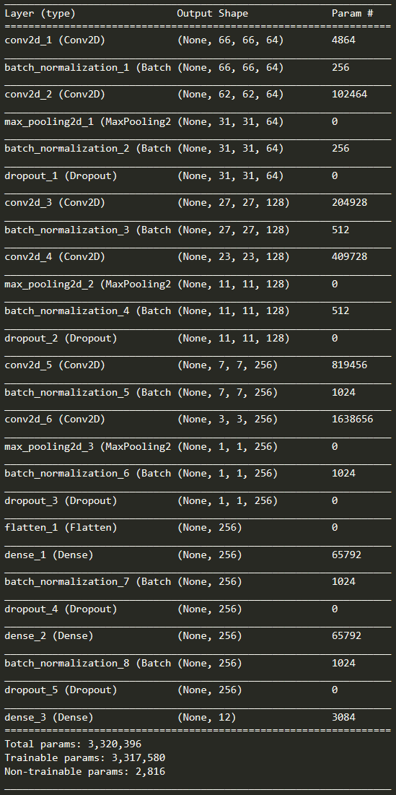
Architecture
17 layers (Conv+Dense)
Batch_normalization
Activation=‘ReLU’
Prevent overfitting
Data augmentation (rotation, zoom, flip, shift)
Dropout

Slide 9
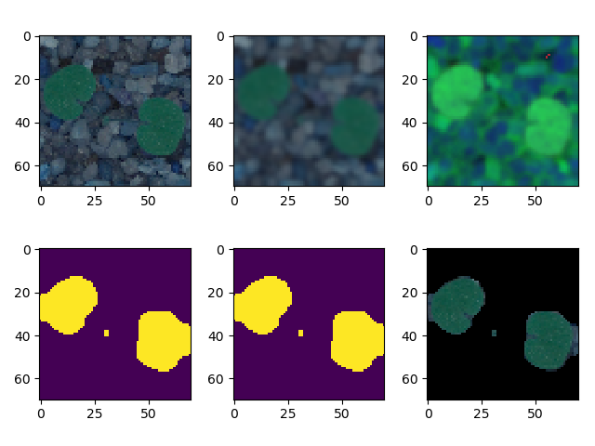
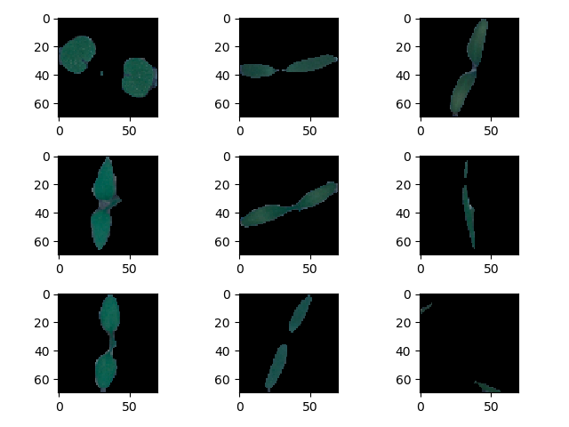
Segmentation
Original image
Gaussian Blur
HSV color space
Green mask
Binary mask
Processed image
Some processed image

Slide 10
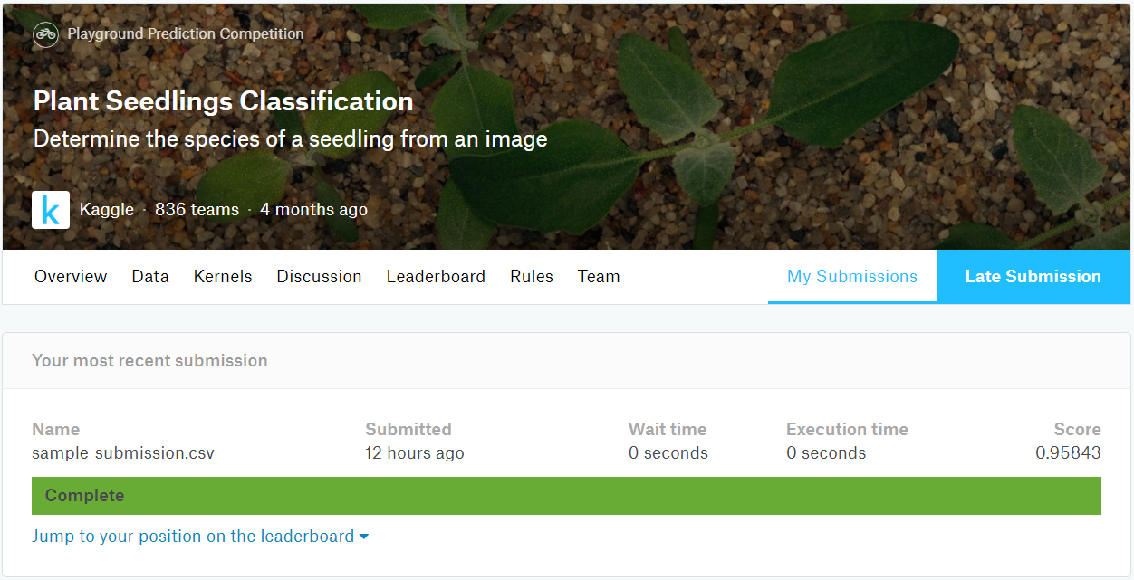
Results and Discussion
Results of the above model

Slide 11
Results and Discussion
Score | Optimizer | Activation | Pre-process | Epoch
0.90635 | SGD | ReLU | Non | 20
0.93823 | Adam | ReLU | Non | 30
0.94268 | SGD | ReLU | Segmentation | 30
0.95649 | Adam | ReLU | Segmentation | 20
0.95843 | Adam | ReLU | Segmentation | 30
0.95963 | Adam | LeakyReLU | Segmentation | 30
0.96325 | Adam | PReLU | Segmentation | 30
0.97017 | Adam | PReLU | Segmentation | 50

Slide 12
Two different models
2
Liu Huazhen

Slide 13
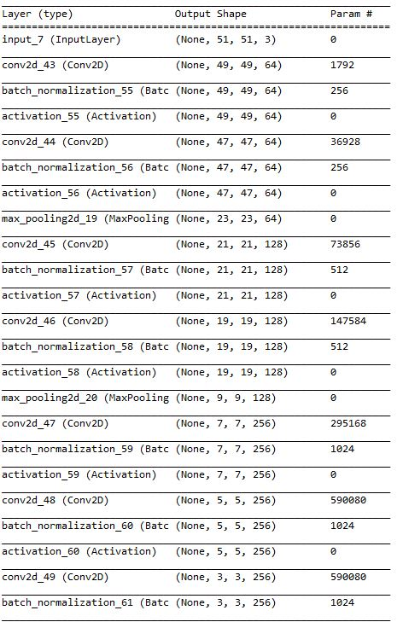
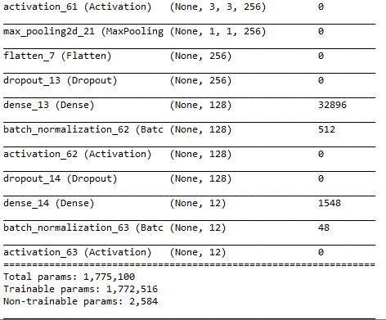
Model
18 layers
Conv+Dense

Slide 14
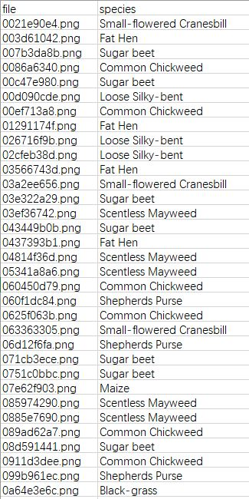
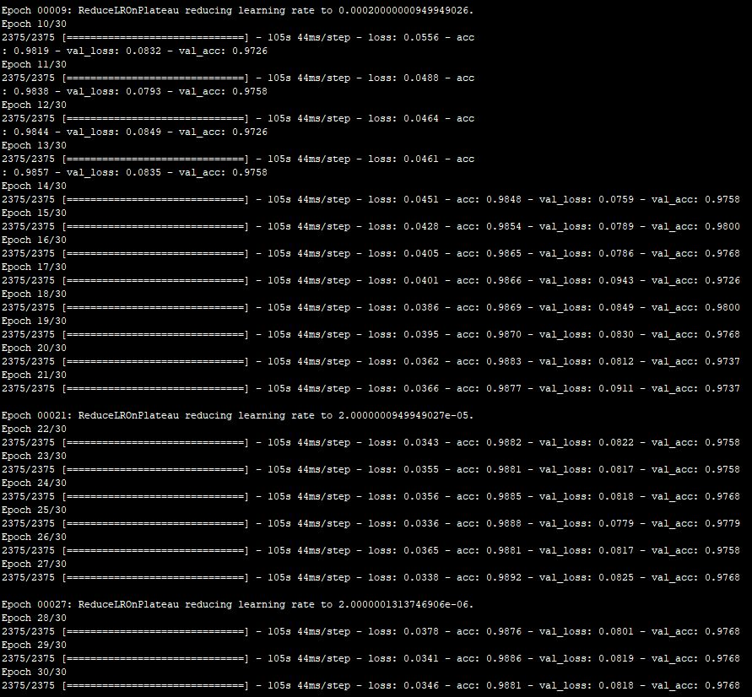
Result
Test score:0.96851
Activation: LeakyReLU
tanh
softmax
Batch_size: 16
Epoch: 50
Optimizer: Adam

Slide 15
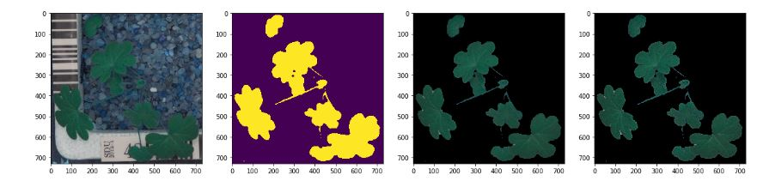
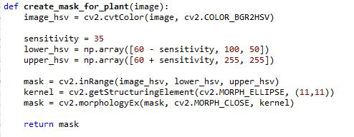


Segmentation
Origin
Mask
Seg
Sharpen

Slide 16
Results and Discussion
Score | Optimizer | Activation | Pre-process | Epoch
0.92947 | Adam | Relu | Segmentation | 10
0.93702 | SGD | Relu | Segmentation | 30
0.94332 | SGD | Relu | Non | 10
0.95340 | Adam | Relu | Non | 10
0.95717 | Adam | Relu | Sharpen | 30
0.95843 | Adam | LeakyReLU | Non | 10
0.96599 | Adam | Relu | Non | 30
0.96725 | Adam | LeakyReLU | Non | 30
0.96851 | Adam | LeakyReLU | Non | 50

Slide 17
Conclusion
From the perspective of plant leaf image recognition, the research status of plant leaf image recognition and convolutional neural network was analyzed. Two different network models were independently established, and image processing algorithms commonly used in image recognition, such as image rotation, image denoising, image enhancement, etc., were discussed. Then, the plants and backgrounds in the image were segmented to obtain better results using OpenCV-based image segmentation technology. In addition, the accuracy of plant seedling classification in convolutional neural networks under different network structures, training algorithms, activation functions, etc., was explored.
Some common problems in the neural network model training process were analyzed, including data normalization, network parameter initialization, learning rate selection and batch training comparison, and mini-batch training method.
Based on the traditional convolutional neural network, two network models suitable for this experiment were built, and good classification results were obtained on platform Kaggle.
Notes:
从植物叶片图像识别的角度出发，检索分析了植物叶片图像识别和卷积神经网络的研究现状。分别独立建立两个不同的网络模型，讨论了在图像识别方面常见的图像处理算法，比如图像旋转、图像去噪、图像增强等等。然后，采取基于OpenCV的图像分割技术，对图像中植物与背景进行分割，以便获得更好的效果。接着，分别探究了卷积神经网络在不同的网络结构、训练算法、激活函数等情况下植物幼苗分类的准确率。
分析了神经网络模型训练过程一些常见的问题，包括数据的归一化、网络参数的初始化、学习速率的选择问题和批量训练的比较，以及 mini-batch 训练方法。
在传统的卷积神经网络的基础上，搭建适合本实验的网络模型，在Kaggle上获得了较好的识别分类结果。

Slide 18
Thanks!

